Slide 1




Team Members: Edwin Alvarez, Alejandro Henao, Leonardo Martin, Piero Messarina Product Owners: Chief Samuel Ceballos, Major Jason Cohen Mentors: Juan Caraballo, Robert Loredo Instructor: Masoud Sadjadi School of Computing and Information Sciences
Senior Project Final Presentation Spring 2016
BOLO 4.0
ANTI-CRIME
INITIATIVE
May 6
Notes:
Greet your audience, thank them for attending your presentation, introduce yourself, introduce your project, introduce your team members, and quickly indicate what each of you did in a high-level manner, and put more emphasis on your part/contribution.

Slide 2
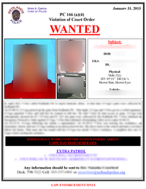
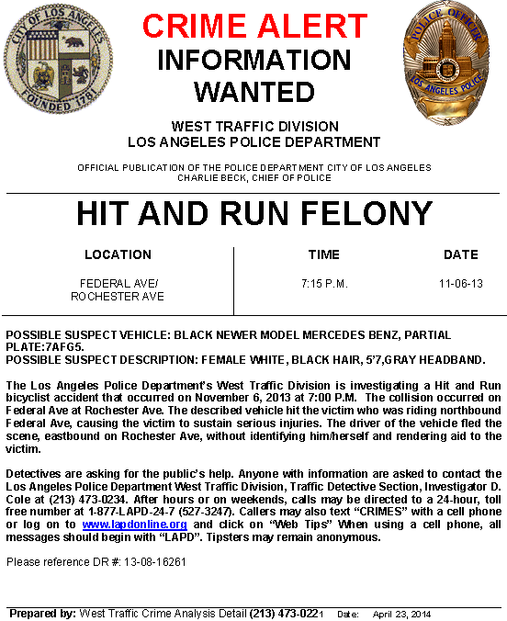
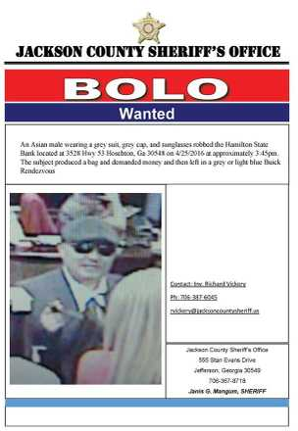
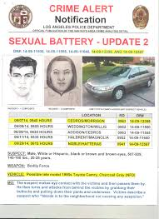
Problem
BOLO 4.0
BOLO (Be On the Look Out) FLYER: Contains sensitive crime information.
BOLO creation and distribution is:
Slow
Costly
Scattered
Disorganized
Elusive
Ineffective
Piero Messarina (piero.messarina@gmail.com)
Notes:
Introduce the problem that the whole project tackles and stay focused on the parts that you have been working. Indicate if there is an existing previous system, enumerate its problems/limitations, etc.

Slide 3
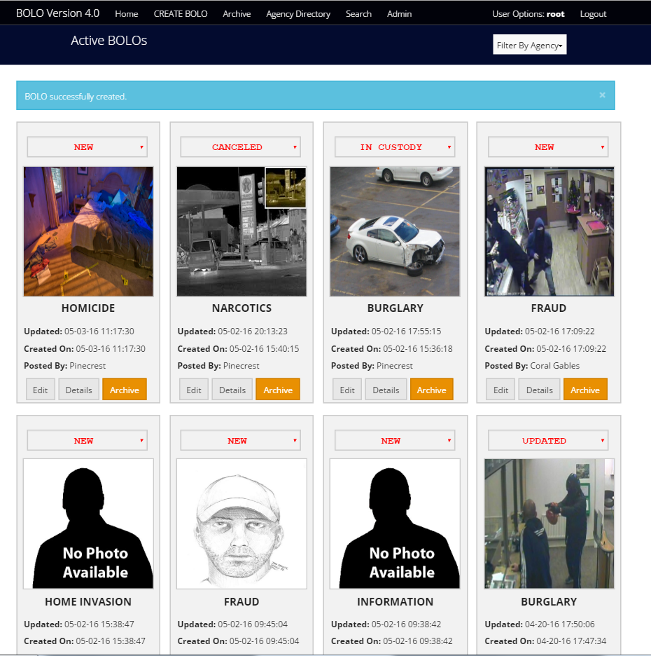

SOLUTION
BOLO 4.0
+CLOUD PLATFORM
+SECURE
+SCALABLE
+DYNAMIC
+ADAPTABLE
Figure 1. BOLO 4.0 Homepage.
Piero Messarina (piero.messarina@gmail.com)

Slide 4
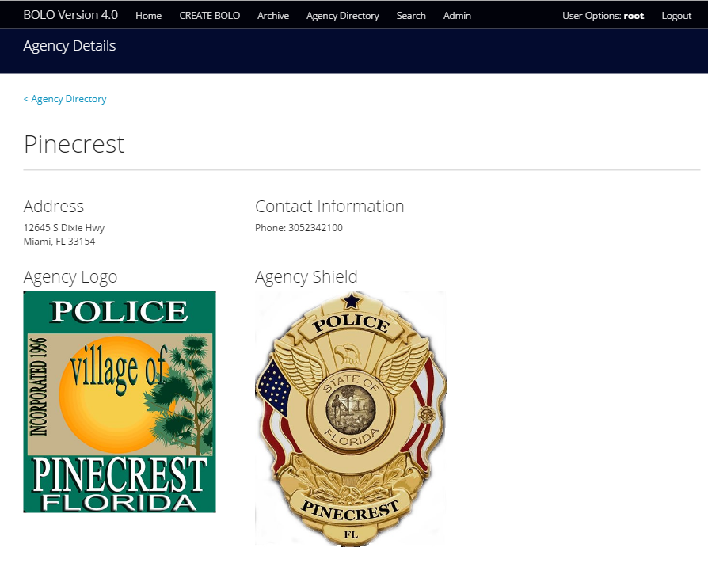
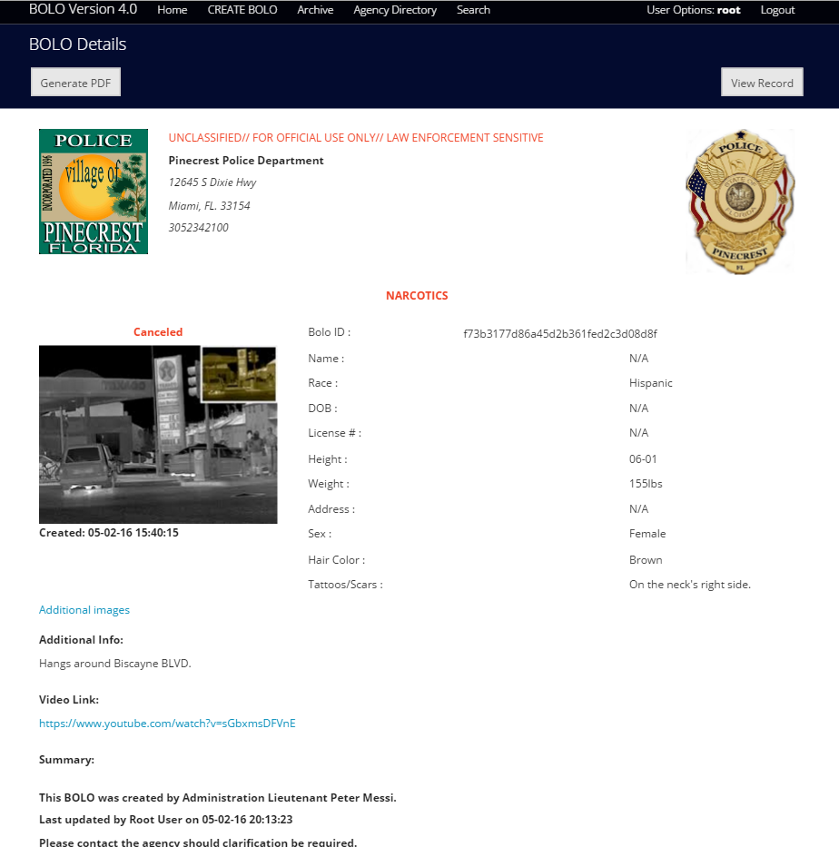
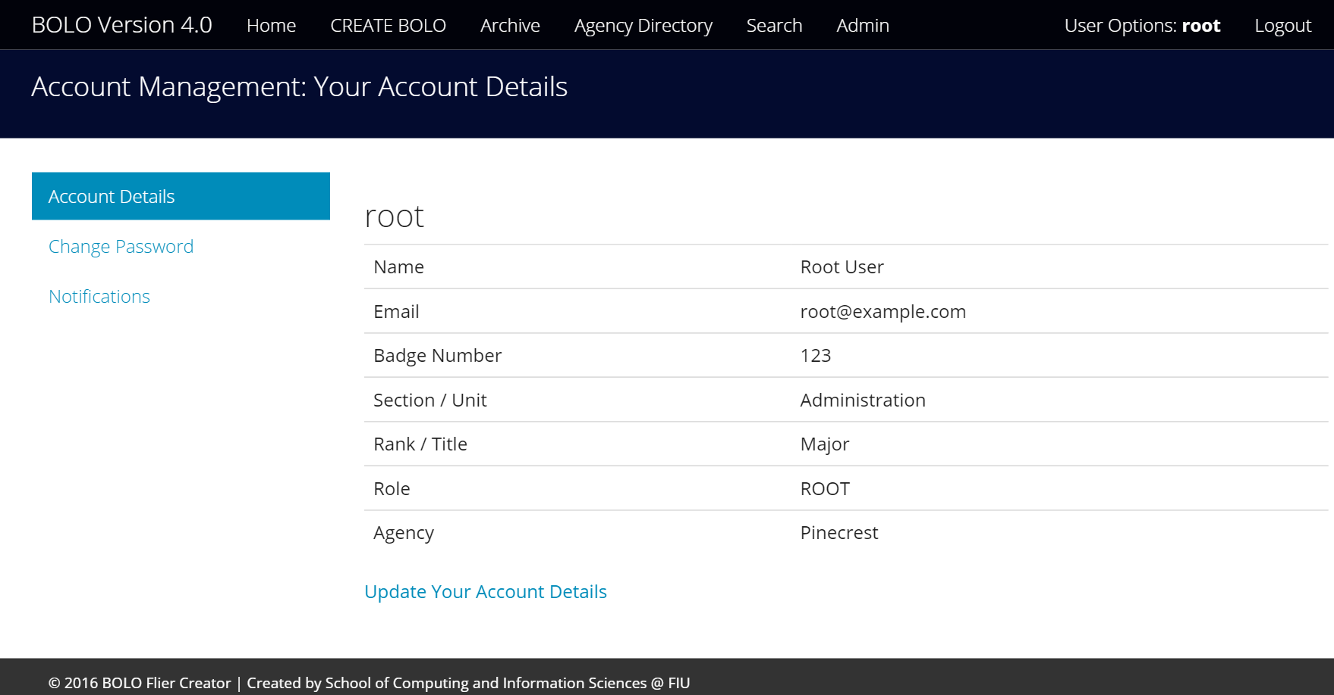
SOLUTION (Main Components)
BOLO 4.0
AGENCIES
BOLOS
USERS
Piero Messarina (piero.messarina@gmail.com)

Slide 5
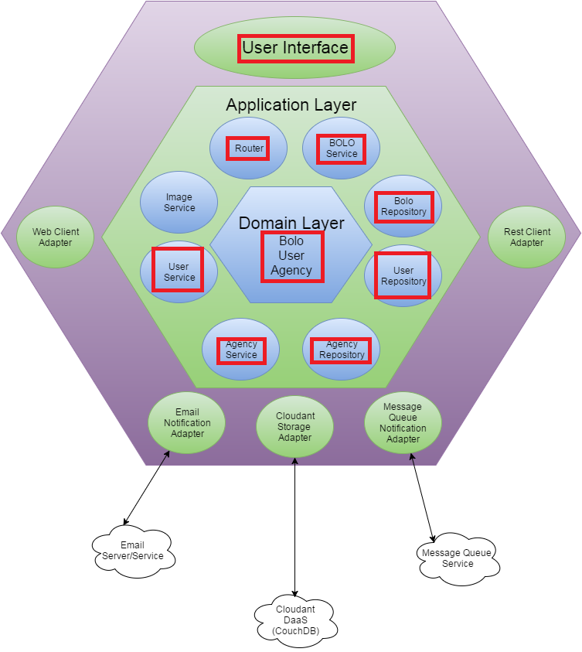
System Architecture
Figure 2. BOLO 4.0 Hexagonal Architecture Diagram.
Piero Messarina (piero.messarina@gmail.com)

Slide 6
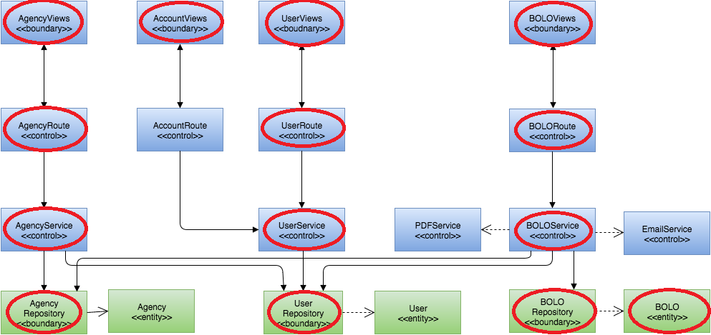







System Design
BOLO 4.0
Figure 3. BOLO 4.0 Minimal Class Diagram
Piero Messarina (piero.messarina@gmail.com)
Notes:
6. Detailed design:
6.1. Minimal class diagram. Identify the design patterns used (one or more slides).
6.2. State machine for the main control object or the most important object of the implemented uses cases (one or more slides).
6.3. Main algorithm used related to an implemented use case described above (one or more slides).

Slide 7
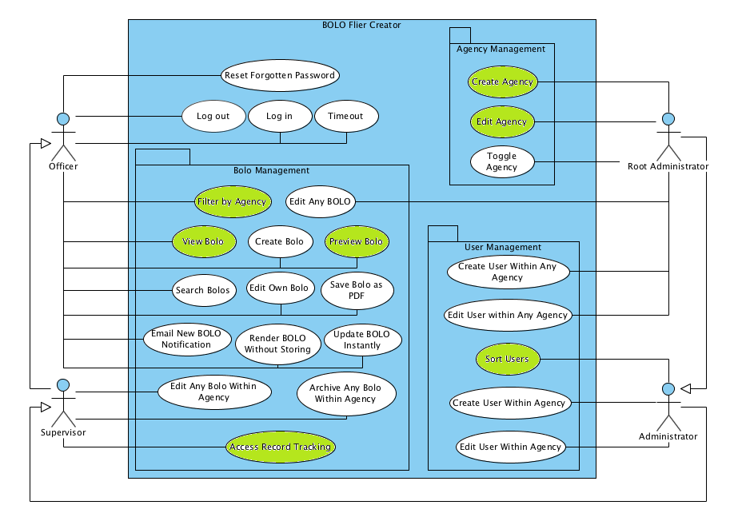
Requirements: Use Cases
Figure 4. BOLO 4.0 Use Case Diagram
Piero Messarina (piero.messarina@gmail.com)
Notes:
4. Requirements:
4.1. User stories implemented (one or more slides).
4.2. UML use cases and the use case diagram for the implemented use cases (one or more slides).
4.3. UML sequence diagrams for the implemented use cases.

Slide 8
Use Case ID: Bolo-589 (View BOLO Flyer)
BOLO 4.0
Actor: User.
Preconditions:
The user must be logged in with proper credentials.
The user navigates to the ‘Homepage View.’
Flow of events:
The user clicks on the ‘Details’ button of a BOLO Thumbnail.
The system identifies the request by ID and retrieves it from the database.
The user is redirected to the ‘Details View’ of the selected BOLO.
Decision Support:
Frequency: High. Users will demand BOLO details constantly.
Criticality: High. It displays vital information, main objective of the system.
Constraints:
Populating the ‘Details View’ should take less than 5 seconds.
Piero Messarina (piero.messarina@gmail.com)

Slide 9
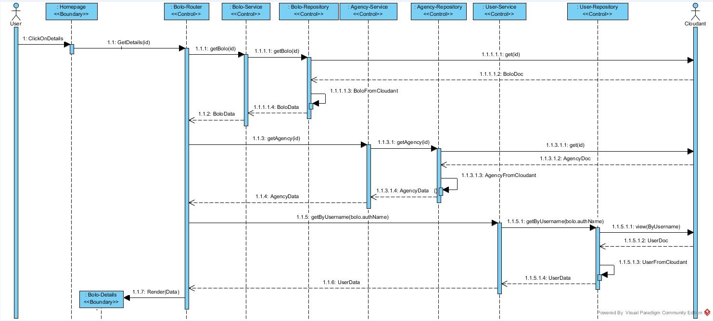
#589 – View BOLO Flyer
BOLO 4.0
Figure 5. View BOLO Flyer Sequence Diagram.
Piero Messarina (piero.messarina@gmail.comu)

Slide 10
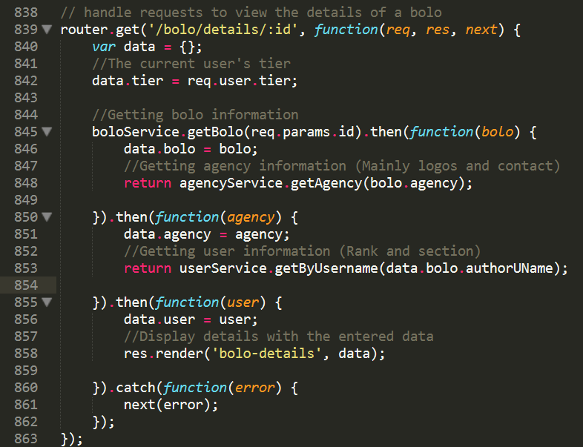
Algorithm
View BOLO Details →
1.Gets BOLO through req.ID →
2. Gets Agency through req.ID →
3. Gets user through bolo.author →
Displays gathered data →
Figure 6. Code Sample (Router)
Piero Messarina (piero.messarina@gmail.com)
Notes:
6. Detailed design:
6.1. Minimal class diagram. Identify the design patterns used (one or more slides).
6.2. State machine for the main control object or the most important object of the implemented uses cases (one or more slides).
6.3. Main algorithm used related to an implemented use case described above (one or more slides).

Slide 11
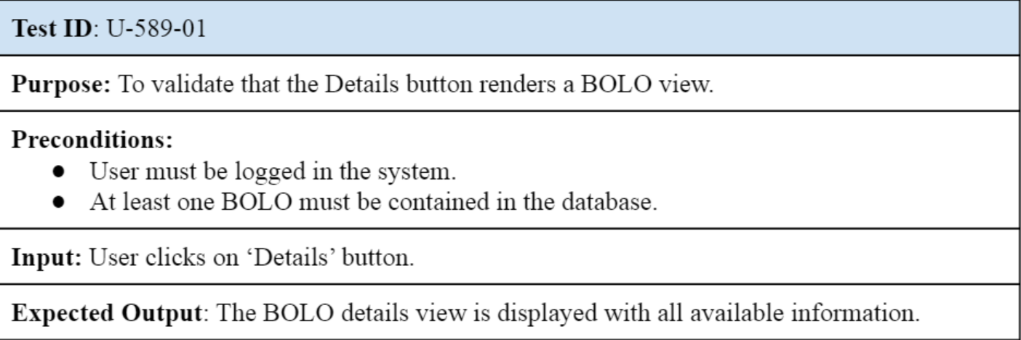
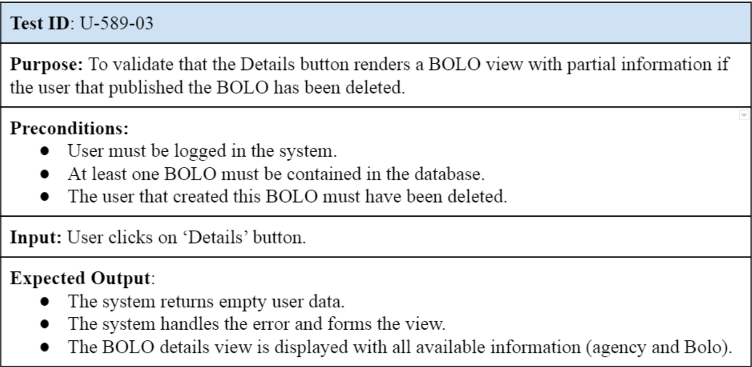

Testing
BOLO 4.0
Sunny Day:
Rainy Day:
Piero Messarina (piero.messarina@gmail.com)

Slide 12
Summary
BOLO 4.0 will help law enforcement to distribute vital crime information in real time.
Developed with: JavaScript, CSS, nodeJS, Jade, Cloudant, Json, IBM Bluemix.
Piero Messarina (piero.messarina@gmail.com)
Questions?
Thank You!
Notes:
Summarize your contribution
Include your contact information
Ask if anyone has any questions for you.
Thank your audience

